Slide 1


Data Prefetchers
Neelanjan Goswami
400414867
McMaster UNIVERSITY
Faculty Advisor:
Dr. Mohamed Hassan
Department of Electrical and Computer Engineering
McMaster University

Slide 2
Contents
Introduction
What is Data Prefetching?
Types of Prefetching
Applications
Hardware Prefetching Basics
Software Modelling Architecture
Implementing Hardware Prefetchers
Code Explanation – Main function
Offset Calculation – Static Prefetcher
Simulation Output
Next Steps
Challenges and Solutions
Future Steps
Key Benefits
Conclusion
References

Slide 3
Introduction
Brief overview of the presentation:
The presentation will cover the concept of data prefetching, its types (static and dynamic), and its implementation.
The importance of data prefetching in computer processors will be discussed.
The presentation will also delve into the basics of hardware prefetching, software modelling architecture, and the use of UML diagrams.
The process of implementing hardware prefetchers and integrating them into the Octopus simulator will be explained.
The presentation will conclude with a discussion on testing using benchmarks.

Slide 4
Introduction
Prefetching is a proactive technique employed by computer processors to enhance performance. It involves the anticipation and retrieval of data or instructions from their storage in slower memory to faster local memory before they are needed. Essentially, it's a strategic way for processors to be ahead of the game, ensuring that necessary information is readily available when called upon for execution.
The primary objective of prefetching is to minimize the time processors spend waiting for data or instructions to be fetched. By fetching data or instructions in advance and storing them in a faster local memory, processors can reduce the latency associated with accessing slower memory, thereby accelerating execution. This proactive approach optimizes the workflow of processors, enabling them to operate more efficiently and deliver improved overall performance.
Prefetching stands out as a pivotal technique in the broader landscape of processor optimization. It plays a crucial role in mitigating the impact of memory access latency, a common bottleneck in computational performance. As processors continue to evolve, the significance of prefetching remains paramount, contributing significantly to the ongoing efforts to enhance the speed and efficiency of modern computing systems.

Slide 5
Introduction
Methods of Prefetching:
Hardware-based Prefetching
Mechanism: Utilizes a dedicated hardware mechanism in the processor.
Monitoring and Identification: The mechanism simultaneously observes the instruction or data stream from the executing program and pinpoints the upcoming elements needed by the program.
Execution: These elements are then prefetched into the processor’s cache.
Software-based Prefetching
Analysis: The compiler analyzes the code.
Insertion: During the process of compilation, the compiler meticulously inserts additional “prefetch” instructions into the program, ensuring that these instructions are strategically placed for optimal execution.
Execution: These prefetch instructions ensure that data and instructions are readily available when needed.

Slide 6
Introduction
Types of Prefetching:
Data Prefetching
Fetches data before it is needed.
Data access patterns show less regularity than instruction patterns, making accurate data prefetching more challenging.
Instruction Prefetching
Fetches instructions before they need to be executed.
Instruction patterns are generally more regular, making instruction prefetching more straightforward.

Slide 7
Introduction
Types of Data Prefetching:
1. Static Prefetching:
Prefetching is determined at compile-time or based on a priori knowledge.
Predictable and deterministic.
Requires analysis of program behavior during compilation.
2. Dynamic Prefetching:
Prefetching decisions are made at runtime based on the program's current execution behavior.
Adapts to varying access patterns during program execution.
Utilizes runtime profiling and feedback mechanisms.
3. Compiler-Inserted Prefetching:
Compiler-generated instructions for prefetching data into the cache.
Relies on compiler analysis to identify prefetching opportunities.
Enhances cache utilization based on compile-time knowledge.
4. Hardware Prefetching:
Prefetching is implemented through specialized hardware units within the processor.
Utilizes on-chip mechanisms to predict and fetch data.
Minimizes software intervention for prefetching.
5. Stream Prefetching:
Predicts and prefetches sequential streams of data.
Particularly effective for applications with predictable access patterns.
Enhances performance in scenarios with regular data strides.

Slide 8
Introduction
Types of Data Prefetching:
6. Sequential Prefetching:
Anticipates the next sequential memory access and prefetches data accordingly.
Benefits applications with contiguous data access patterns.
Helps mitigate latency by fetching upcoming data in advance.
7. Temporal Prefetching:
Prefetches data that is likely to be accessed in the near future based on past behavior.
Relies on temporal locality for prefetching decisions.
Aims to exploit recurring access patterns within short time intervals.
8. Spatial Prefetching:
Prefetches data located near the current access address in memory.
Exploits spatial locality to bring in additional data from nearby addresses.
Improves cache hit rates by fetching related data.
9. Markov Prefetching:
Applies Markov models to predict future memory accesses for prefetching.
Utilizes probability-based predictions for prefetching decisions.
Adapts to varying access patterns through statistical modeling.
10. Pattern-Based Prefetching:
Prefetching based on identified patterns in memory access sequences. - *
Recognizes recurring patterns and prefetches data accordingly. - Effective in scenarios where access patterns exhibit regularity.

Slide 9
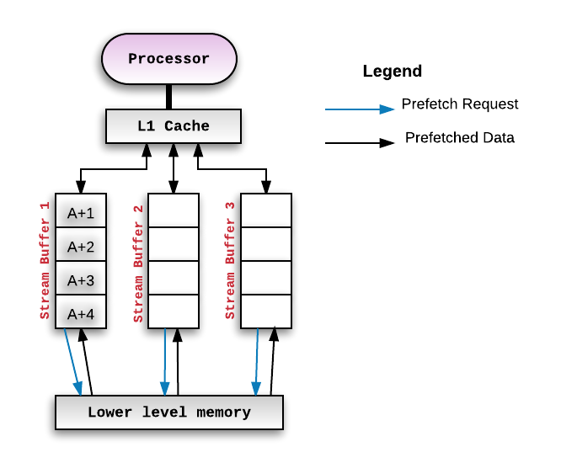
Introduction
Figure 1. A typical stream buffer setup
Notes:
The diagram you’re referring to illustrates the concept of Cache Prefetching. Here’s a breakdown of the components:
Processor: This is where the execution of instructions takes place. It’s represented by a purple oval at the top of the diagram.
L1 Cache: This is a type of cache memory that has a small capacity but is very fast. It’s the first level of cache that the processor checks for data. It’s represented by a red rectangle below the processor.
Stream Buffers: These are used to hold prefetched data from the lower level memory. There are four of them in the diagram, represented by red rectangles below the L1 Cache.
Lower Level Memory: This is where the data is initially stored before it’s fetched. It’s represented by a blue rectangle at the bottom of the diagram.
The diagram shows how the processor requests data from the lower level memory. If the data isn’t in the L1 Cache (a cache miss), the prefetch mechanism is triggered. This mechanism fetches data from the lower level memory and stores it in the stream buffers. The processor can then access this data from the stream buffers, reducing the latency that would have been incurred if it had to fetch the data from the lower level memory. This process is what’s known as Cache Prefetching.
Detection of a Cache Miss: Whenever the prefetch mechanism detects a miss on a memory block, it triggers the stream buffer setup¹.
Allocation of a Stream: The prefetch mechanism allocates a stream to begin prefetching successive blocks from the missed block onward¹.
Creation of a Stream Buffer: The cache miss address and subsequent addresses are fetched into a separate buffer. This buffer is called a stream buffer and is separate from the cache¹.
Consumption of Data/Instructions: The processor then consumes data/instructions from the stream buffer if the address associated with the prefetched blocks matches the requested address generated by the program executing on the processor¹.

Slide 10
What is Data Prefetching?
Definition of Data Prefetching
Data prefetching is a technique used by computer processors to anticipate the need for data.
It involves fetching instructions or data from their original storage in slower memory to a faster local memory before it is needed.
Purpose of Data Prefetching
The main purpose of data prefetching is to hide the latency of data fetch operations.
It aims to ensure that the required data is available in the cache when it is needed, thereby reducing cache misses and improving execution performance.
How Data Prefetching Boosts Execution Performance
By fetching data in advance, data prefetching reduces the time the processor has to wait for data to be fetched from memory.
This leads to a reduction in memory latency, which can significantly boost the overall execution performance of the processor.
It allows the processor to continue executing other instructions without having to wait for data fetch operations to complete.

Slide 11
Types of Prefetching
Static Prefetching
Definition: Static prefetching is a technique that fetches data based on a fixed pattern or algorithm. It’s a type of data prefetching that relies on a predetermined pattern to fetch data in advance.
Adaptability: Unlike dynamic prefetching, static prefetching does not adapt to changes in the program’s behavior or data access patterns. It operates on a set pattern and does not change its behavior based on the program’s data access patterns.
Effectiveness: Static prefetching can be highly effective for predictable data access patterns. However, its performance may decline with unpredictable or dynamic data access patterns as it cannot adapt to changes in data access behavior.

Slide 12
Types of Prefetching
Dynamic Prefetching
Definition: Dynamic prefetching is another type of data prefetching that adapts to the program’s behavior and data access patterns. It’s more flexible than static prefetching as it changes its behavior based on the program’s data access patterns.
Predictive Nature: Dynamic prefetching uses past behavior to predict future data needs. It analyzes the program’s past data access patterns to predict which data will be needed in the future and fetches this data in advance.
Flexibility and Effectiveness: The adaptive nature of dynamic prefetching makes it more flexible and effective for a wider range of data access patterns compared to static prefetching. It can adapt to changes in data access behavior and maintain high performance even with unpredictable data access patterns.

Slide 13
Applications
Static Prefetching
Use Cases: Static prefetching is often used when data access patterns are predictable. It can be particularly effective in scenarios where the same data or instructions are repeatedly accessed.
Examples: One common example of static prefetching is prefetching static assets like scripts or stylesheets when subsequent sections the user might visit can be predicted. This is especially useful when those assets are shared across many pages.
Dynamic Prefetching
Use Cases: Dynamic prefetching is used when data access patterns are less predictable and can change dynamically. It’s particularly useful in scenarios where data access patterns can vary based on user behavior or other factors.
Examples: An example of dynamic prefetching is in Next.js, a popular React framework, where dynamic routing on both the client and server side is used to prefetch data based on user navigation patterns. Another example is the dynamic recognition prefetch engine for hybrid main memory systems consisting of dynamic random-access memory (DRAM) and phase-change memory (PCM) components, which can be especially used for big data applications and massive-scale computing environment.

Slide 14
Hardware Prefetching Basics
Introduction to Hardware Prefetching
Boosts Execution Performance: Hardware prefetching is a technique that significantly boosts the execution performance of computer processors.
Minimizes Data Retrieval Time: The main purpose of hardware prefetching is to minimize the time a processor spends waiting for data retrieval.
Enhances System Efficiency: By reducing data retrieval time, hardware prefetching enhances the overall efficiency of the system.
Mechanism of Hardware Prefetching
Fetches Instructions or Data in Advance: The process involves fetching instructions or data from their original storage in slower memory to a faster local memory before it is needed.
Involves Dedicated Hardware Mechanism: This is typically accomplished by a dedicated hardware mechanism in the processor.
Monitors Instruction or Data Stream: The hardware mechanism monitors the stream of instructions or data being requested by the executing program, allowing it to predict and fetch the required data in advance.

Slide 15
Hardware Prefetching Basics
Performance Enhancement: By predicting and fetching the required data in advance, hardware prefetching can significantly reduce memory latency and improve the overall performance of the processor.
Dependence on Prediction Accuracy: However, it’s important to note that the effectiveness of hardware prefetching relies heavily on the accuracy of the prediction algorithm used.
Benefits of Hardware Prefetching
Efficient Utilization of Processor: Hardware prefetching allows the processor to work at its maximum capacity without being stalled due to data fetch delays. This leads to more efficient utilization of the processor’s capabilities.
Improved System Performance: By reducing memory latency, hardware prefetching can significantly improve the overall performance of the system. This can be particularly beneficial in systems where high performance is a critical requirement.
Enhanced User Experience: Hardware prefetching enhances system performance, creating a smoother user experience, especially in data-intensive work.
Implications of Hardware Prefetching

Slide 16
Hardware Prefetching Basics
Considerations and Limitations
Cache Pollution: Hardware prefetching can significantly enhance performance by fetching data before it’s needed. However, it can sometimes lead to cache pollution, where unnecessary data displaces useful data in the cache, reducing cache hits and increasing misses. This can degrade performance and counteract prefetching benefits. Therefore, an effective prefetching algorithm that accurately predicts needed data is crucial.
Prediction Accuracy: Hardware prefetching’s success hinges on the prediction algorithm’s accuracy. Frequent mispredictions can lead to unnecessary memory use and system slowdowns. Therefore, an accurate prediction algorithm, which minimizes wrong data fetching and cache pollution, is key to effective hardware prefetching.
Resource Consumption: Hardware prefetching, while beneficial, requires additional processor resources, increasing design complexity and cost. It involves monitoring data streams, making predictions, and fetching data, all of which increase power consumption. Furthermore, the prefetching mechanism occupies processor chip space, adding to manufacturing costs and complexity.

Slide 17

Milestone 1
One page IEEE format with the following sections:
– Introduction: high-level context of the problem
– solution: what you will do with a UML diagram for your software modelling architecture and different classes/interfaces

Slide 18
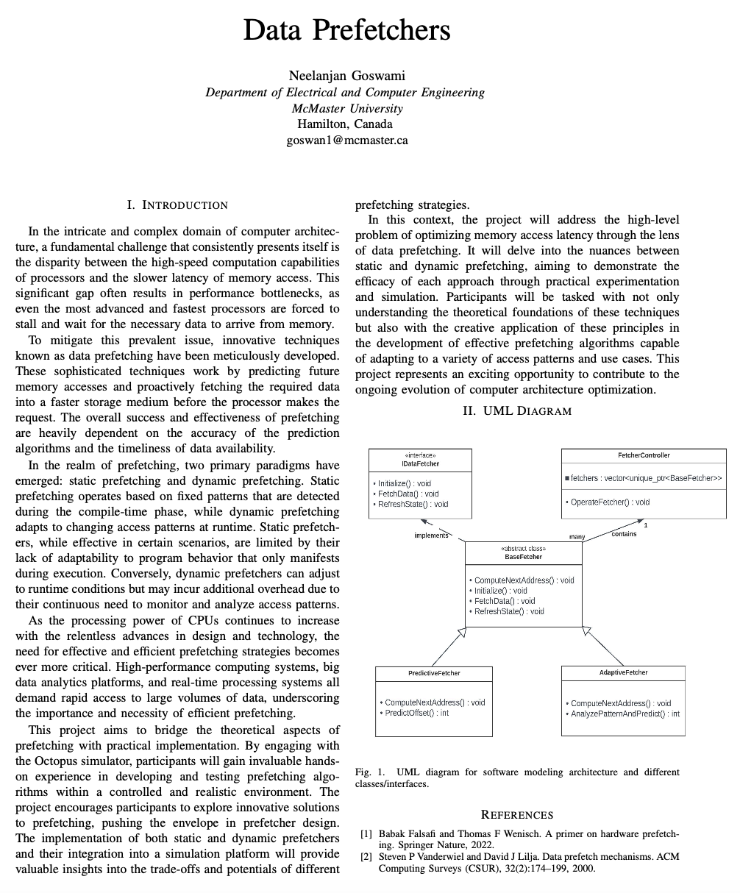
One Page IEEE Report and UML Diagram

Slide 19
Milestone 2
Milestone 2: Standalone simulator with testing

Slide 20
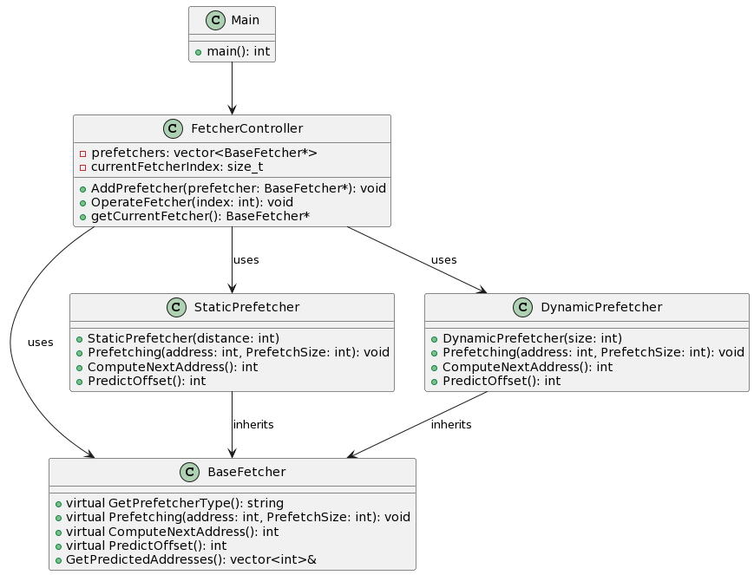
Software Modelling Architecture
Figure 2. UML Diagram

Slide 21
Software Modelling Architecture
UML Diagram Overview:
Main Class (Main):
Serves as the entry point for the program.
Contains the main function, initiating program execution.
FetcherController Class (FetcherController):
Dynamically manages prefetchers.
Coordinates and controls prefetching activities.
Uses instances of:
BaseFetcher: Common interface for fetchers.
StaticPrefetcher: Implements static prefetching.
DynamicPrefetcher: Implements dynamic prefetching.

Slide 22
Software Modelling Architecture
UML Diagram Overview:
StaticPrefetcher Class (StaticPrefetcher):
Inherits from BaseFetcher.
Implements static prefetching based on a specified distance.
DynamicPrefetcher Class (DynamicPrefetcher):
Inherits from BaseFetcher.
Implements dynamic prefetching using a history buffer of a specified size.

Slide 23
Software Modelling Architecture
UML Diagram Overview:
BaseFetcher Class (BaseFetcher):
Abstract class defining a common interface for fetchers.
Virtual functions include:
GetPrefetcherType(): Retrieves the type of the prefetcher.
Prefetching(): Initiates prefetching based on the prefetch size.
ComputeNextAddress(): Computes the next memory address.
PredictOffset(): Predicts the prefetch offset.
GetPredictedAddresses(): Retrieves predicted addresses.

Slide 24
Software Modelling Architecture
Relationships:
Main class is associated with FetcherController.
FetcherController class uses instances of BaseFetcher, StaticPrefetcher, and DynamicPrefetcher.
Inheritance relationships exist between StaticPrefetcher and BaseFetcher, and between DynamicPrefetcher and BaseFetcher.

Slide 25
Implementing Hardware Prefetchers
Steps to Implement Hardware Prefetchers:
Adjust Prefetch Distances:
Consider cache line sizes and memory access patterns.
Implement in Hardware:
Code prefetching logic in hardware description languages (HDLs) like Verilog or VHDL.
Leverage available hardware resources efficiently.
Test and Validate:
Develop comprehensive test scenarios to evaluate prefetcher effectiveness.
Validate prefetching behavior under various workloads.
Optimize for Energy Efficiency:
Implement power-efficient strategies to minimize energy consumption.
Consider dynamic adjustment of prefetch aggressiveness.

Slide 26
Implementing Hardware Prefetchers
Steps to Implement Hardware Prefetchers:
Define Prefetcher Types:
Identify and categorize prefetcher types based on desired strategies.
Common types include stride prefetchers, stream prefetchers, and next-line prefetchers.
Select Prefetching Algorithm:
Choose an appropriate algorithm for each prefetcher type.
Consider factors like memory access patterns, cache size, and associativity.
Integrate with Cache Hierarchy:
Understand the existing cache hierarchy.
Integrate prefetchers seamlessly into the memory subsystem.
Adjust Prefetch Distances:
Fine-tune prefetch distances for optimal performance.

Slide 27
Code Explanation – Main function
Memory Access Traces:
Reads hexadecimal memory access traces from "trace.txt."
Populates a vector with memory access values.
Cache Characteristics:
Specifies cache properties:
Associativity: 4
Cache Size: 64KB
Max Cache Size: 256KB
Prefetcher Aggressiveness:
Determines prefetcher aggressiveness based on cache size.
Adjusts prefetch size dynamically during hits and misses.
Prefetcher Configurations:
Static Prefetcher:
Utilizes a fixed stride value.
Dynamic Prefetcher:
Utilizes a dynamic history buffer.

Slide 28
Code Explanation – Main function
FetcherController Management:
Creates a FetcherController to manage prefetchers.
Adds instances of Static and Dynamic Prefetchers to the controller.
Simulation Loop:
Sequentially operates both prefetchers in a simulation loop.
Demonstrates prefetching actions for each memory access.
Hit and Miss Tracking:
Tracks hits and misses for both prefetchers.
Adjusts prefetch size based on hit or miss outcomes.
Timing Measurement:
Measures and displays the time taken by each prefetcher for each memory access.
Performance Metrics:
Calculates total and average time taken by both prefetchers.
Computes hit and miss rates for Static and Dynamic Prefetchers.

Slide 29
Code Explanation – BaseFetcher.h
Purpose:
Abstract base class for various prefetcher types.
Provides a common interface for different prefetchers.
Attributes:
lastFetchedAddress: Keeps track of the last accessed memory address.
predictedAddresses: Stores the addresses predicted by the prefetcher.
dynamicBuffer: Maintains a buffer for dynamic prefetching.
Virtual Functions:
GetPrefetcherType(): Returns the type of the prefetcher.
Prefetching(): Abstract method for prefetching based on the prefetch size.
ComputeNextAddress(): Abstract method for calculating the next prefetch address.
PredictOffset(): Abstract method for predicting the offset.

Slide 30
Code Explanation – FetcherController.h
Purpose:
Manages and controls multiple prefetchers.
Attributes:
prefetchers: Vector storing pointers to different prefetchers.
currentFetcherIndex: Index of the currently active prefetcher.
Functions:
AddPrefetcher(): Adds a new prefetcher to the controller.
OperateFetcher(): Switches to the next prefetcher based on the provided index.
getCurrentFetcher(): Returns the currently active prefetcher.
Destructor:
Ensures proper memory deallocation by deleting prefetchers.

Slide 31
Code Explanation – StaticPrefetcher.h
Purpose:
Implements static (stride-based) prefetching.
Attributes:
prefetchDistance: Distance between consecutive prefetched addresses.
Functions:
Prefetching(): Implements static prefetching by predicting addresses based on a fixed distance.
ComputeNextAddress(): Calculates the next address based on the fixed prefetch distance.
PredictOffset(): Returns the static prefetch distance.

Slide 32
Code Explanation – DynamicPrefetcher.h
Purpose:
Implements dynamic prefetching based on a history buffer.
Attributes:
dynamicHistoryBufferSize: Size of the dynamic history buffer.
Functions:
Prefetching(): Implements dynamic prefetching by maintaining a history buffer.
ComputeNextAddress(): Calculates the next address based on the dynamic history.
PredictOffset(): Predicts the offset for dynamic prefetching.

Slide 33
Offset Calculation – Static Prefetcher
Initialization:
The prefetch distance (prefetchDistance) is set during the creation of the StaticPrefetcher object.
PredictOffset() Function:
The PredictOffset() function simply returns the predefined prefetchDistance.
Example:
If prefetchDistance is set to 16, the PredictOffset() will always return 16.
Result:
Addresses are prefetched at a constant interval defined by the prefetchDistance.

Slide 34
Offset Calculation – Dynamic Prefetcher
Initialization:
Analyzes the history buffer, which contains the differences between consecutive addresses.
PredictOffset() Function:
Returns the calculated dynamic stride.
Example:
If the history buffer contains differences [20, 25, 18], the average stride is (20 + 25 + 18) / 3 = 21.
Result:
Addresses are prefetched based on the dynamically calculated stride, adapting to the varying access patterns.
Computes the average stride based on historical differences.

Slide 35
Offset Calculation
Key Takeaways:
Static Prefetcher:
Fixed, predetermined prefetch distance.
Simple, consistent, and less adaptive to changing patterns.
Dynamic Prefetcher:
Calculates stride based on historical access patterns.
Adapts to varying access patterns but may introduce more complexity.

Slide 36
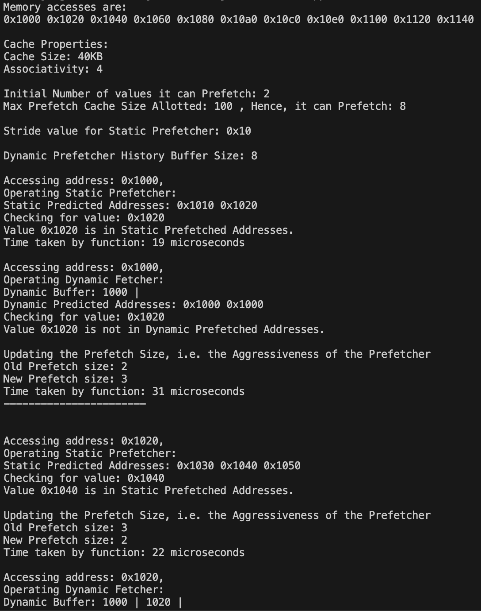
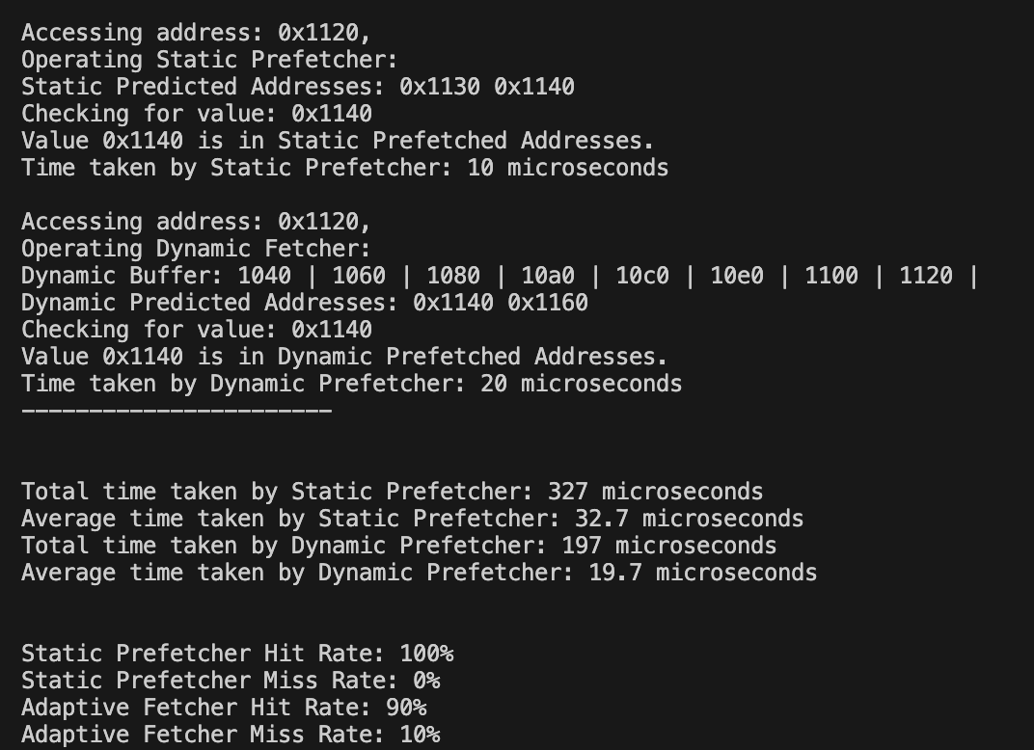
Simulation Output
Figure 3. Simulation Results

Slide 37
Milestone 3
Milestone 3 (Final):
– Integration with Octopus – a 5-page IEEE paper format report

Slide 38
Next Steps
Utilize the interface class with virtual functions, i.e. FetcherController, to control the switching between Static and Dynamic Prefetcher.
Modify the file CacheController.cpp and CacheDataHandler_COTS.cpp in: project-octopus/src/MultiCoreSim/model/src to act as point which calls FetcherController and intitates the prefetching as well as checks for the addresses if already prefetched.
Introduce prefetching mechanism between L1 and L2 levels
Integration with Octopus:

Slide 39
Challenges and Solutions
Cache Pollution:
Challenge: Prefetching irrelevant data, leading to cache pollution.
Prefetcher Stall:
Challenge: Prefetchers may stall the pipeline if predictions are incorrect.
Dynamic Workloads:
Challenge: Adapting to dynamic program behaviors.
Solution: Implement heuristics to filter prefetch requests based on relevance.
Solution: Include mechanisms to cancel or adjust prefetching on mispredictions.
Solution: Implement adaptive prefetchers that adjust to changing access patterns.

Slide 40
Challenges and Solutions
Memory Bandwidth:
Challenge: Excessive prefetching causing high memory bandwidth usage.
Solution: Implement mechanisms to throttle prefetching during high bandwidth demand.
Integration Overheads:
Challenge: Integrating prefetchers without disrupting existing system components.
Solution: Employ modular design principles, allowing for seamless integration.
Power Consumption:
Challenge: High power consumption in aggressive prefetching scenarios.
Solution: Implement power-aware algorithms and dynamically adjust prefetch aggressiveness based on power constraints.

Slide 41
Future Steps
Performance Monitoring:
Implement monitoring mechanisms to track prefetcher performance in real-time.
Use performance counters to evaluate effectiveness.
Feedback Mechanisms:
Implement feedback loops to dynamically adjust prefetching strategies based on runtime observations.
Use machine learning algorithms for adaptive prefetching.
Documentation and Reporting:
Document implemented prefetching strategies and their impact on system performance.
Generate reports summarizing prefetcher effectiveness and areas for improvement.

Slide 42
Key Benefits
Modularity:
Clear separation of concerns for main logic and prefetching strategies.
Facilitates maintenance and enhances code readability.
Extensibility:
Easily extends the system by adding new fetcher types without modifying existing code.
Adaptability:
Allows runtime selection and operation of different prefetching strategies.
Adapts to varying access patterns.

Slide 43
Conclusion
Prefetching's Crucial Role: Emphasize the pivotal role of prefetching in modern processors, highlighting its ability to proactively reduce memory latency and enhance overall system performance.
Adaptive Strategies for Efficiency: Conclude by underlining the importance of adaptive prefetching strategies, balancing the trade-offs between performance and potential challenges like cache pollution and power consumption.
Continuous Evolution: Conclude on a forward-looking note, stressing the ongoing evolution of prefetching techniques. As processors advance, the adaptability and efficiency of prefetching will remain central to meeting the demands of ever-changing computing environments.

Slide 44

References
Babak Falsafi and Thomas F Wenisch. A primer on hardware prefetching. Springer Nature, 2022.
Steven P Vanderwiel and David J Lilja. Data prefetch mechanisms. ACM Computing Surveys (CSUR), 32(2):174–199, 2000.

Slide 45

Questions ?

Slide 46
Thank You

